Slide 1
CSS Box Model 與定位方式
The Box Model and Position

Slide 2
大綱
Box Model
邊界屬性
留白屬性
框線屬性
定位方式

Slide 3
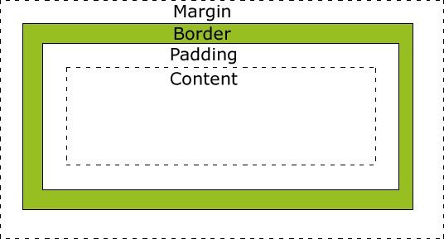
Box Model
留白(padding)、框線(border) 、邊界(margin)
Notes:
http://www.w3schools.com/css/css_boxmodel.asp

Slide 4
邊界屬性 Margin
Property | Description
margin | A shorthand property for setting the margin properties in one declaration
margin-bottom | Sets the bottom margin of an element
margin-left | Sets the left margin of an element
margin-right | Sets the right margin of an element
margin-top | Sets the top margin of an element

Slide 5
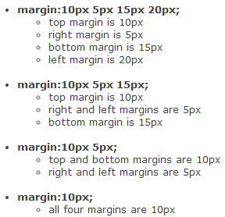
邊界屬性 Margin
上、右、下、左
上、左右、下
上下、左右
上下左右
Notes:
http://www.w3schools.com/cssref/pr_margin.asp

Slide 6
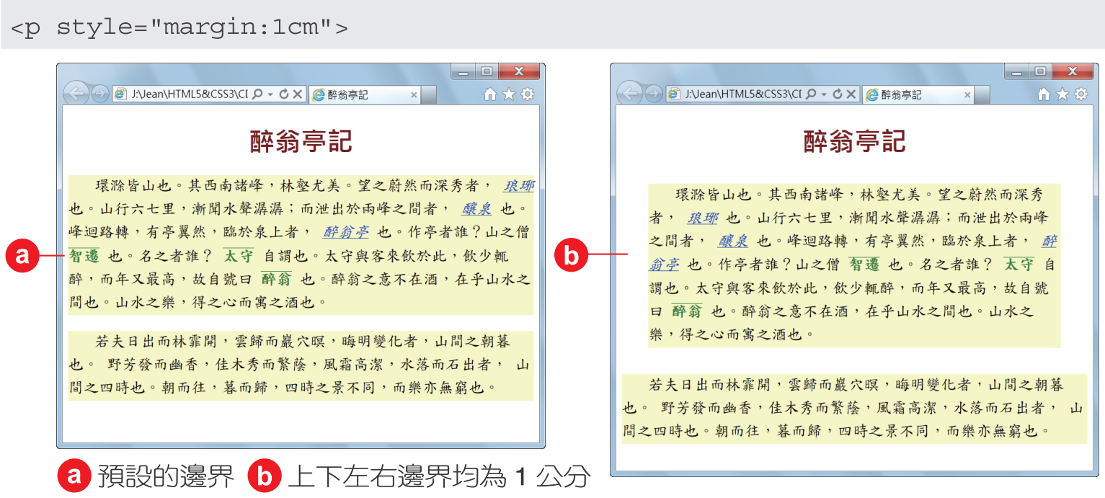
邊界屬性 Margin

Slide 7
留白屬性 Padding
Property | Description
padding | A shorthand property for setting all the padding properties in one declaration
padding-bottom | Sets the bottom padding of an element
padding-left | Sets the left padding of an element
padding-right | Sets the right padding of an element
padding-top | Sets the top padding of an element
Notes:
http://www.w3schools.com/css/css_padding.asp

Slide 8
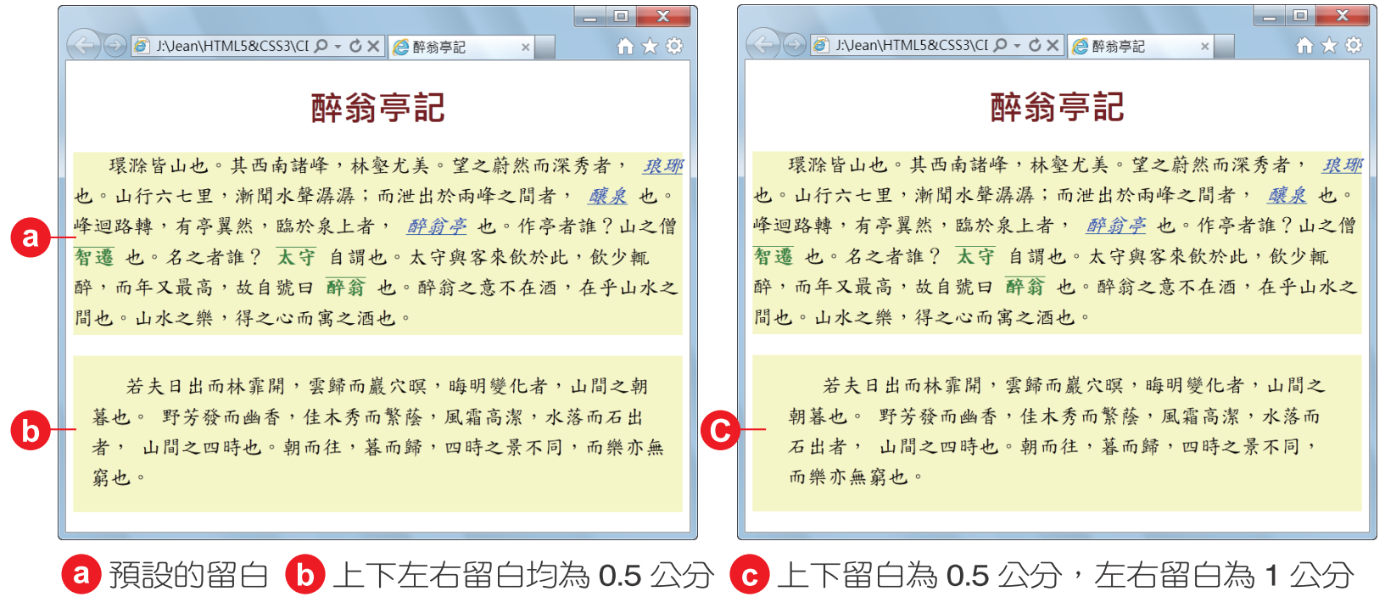
留白屬性 Padding
<p style='padding:1cm'>
<p style='padding:0.5cm 1cm'>

Slide 9
框線屬性 Border
Property | Description
border | Sets all the border properties in one declaration
border-width | Sets the width of the four borders
border-style | Sets the style of the four borders
border-color | Sets the color of the four borders
border-top | Sets all the top border properties in one declaration
border-top-color | Sets the color of the top border
border-top-style | Sets the style of the top border
border-top-width | Sets the width of the top border

Slide 10
框線屬性 Border
Property | Description
border-bottom | Sets all the bottom border properties in one declaration
border-bottom-color | Sets the color of the bottom border
border-bottom-style | Sets the style of the bottom border
border-bottom-width | Sets the width of the bottom border
border-left | Sets all the left border properties in one declaration
border-left-color | Sets the color of the left border
border-left-style | Sets the style of the left border
border-left-width | Sets the width of the left border
border-right | Sets all the right border properties in one declaration
border-right-color | Sets the color of the right border
border-right-style | Sets the style of the right border
border-right-width | Sets the width of the right border

Slide 11
框線屬性 Border
Value | Description
none | Specifies no border
hidden | The same as "none", except in border conflict resolution for table elements
dotted | Specifies a dotted border
dashed | Specifies a dashed border
solid | Specifies a solid border
double | Specifies a double border
groove | Specifies a 3D grooved border. The effect depends on the border-color value
ridge | Specifies a 3D ridged border. The effect depends on the border-color value
inset | Specifies a 3D inset border. The effect depends on the border-color value
outset | Specifies a 3D outset border. The effect depends on the border-color value
Notes:
http://www.w3schools.com/cssref/pr_border-style.asp

Slide 12
Display 屬性
Value | Description
inline | Default. Displays an element as an inline element (like <span>)
block | Displays an element as a block element (like <p>)
inline-block | Displays an element as an inline-level block container. The inside of this block is formatted as block-level box, and the element itself is formatted as an inline-level box
inline-table | The element is displayed as an inline-level table
list-item | Let the element behave like a <li> element
run-in | Displays an element as either block or inline, depending on context
none | The element will not be displayed at all (has no effect on layout)
Notes:
http://www.w3schools.com/cssref/pr_class_display.asp

Slide 13
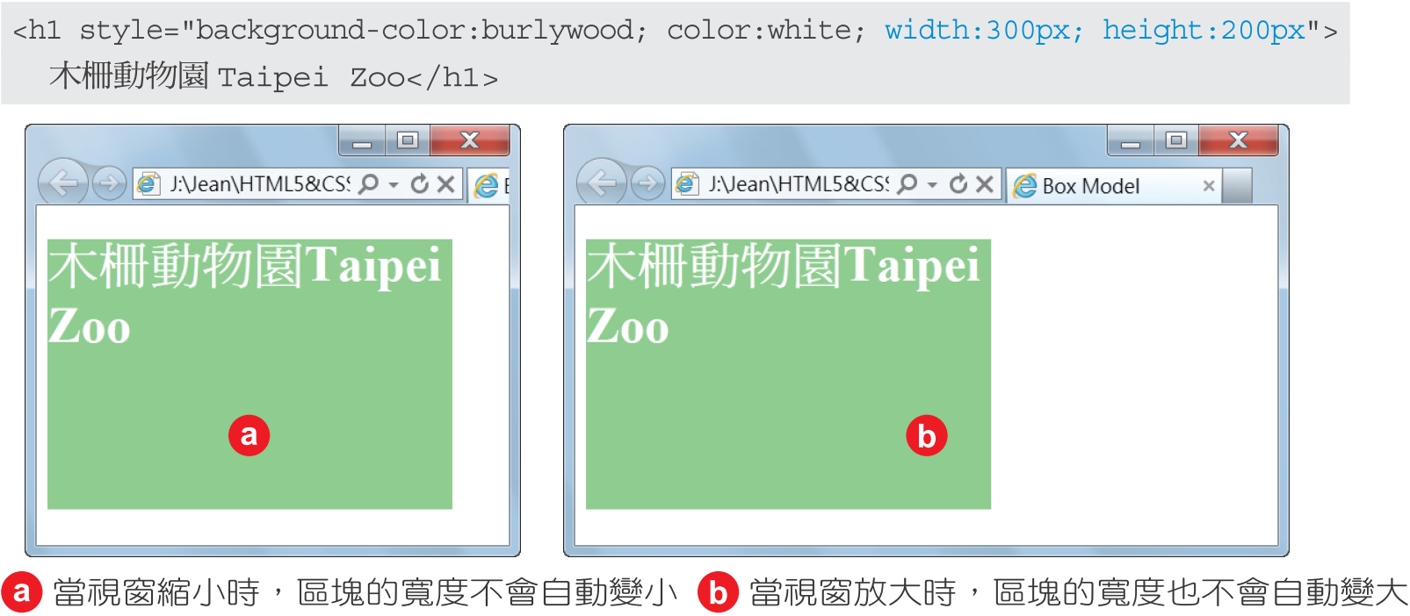
寬度下限 min-width 寬度上限 max-width

Slide 14
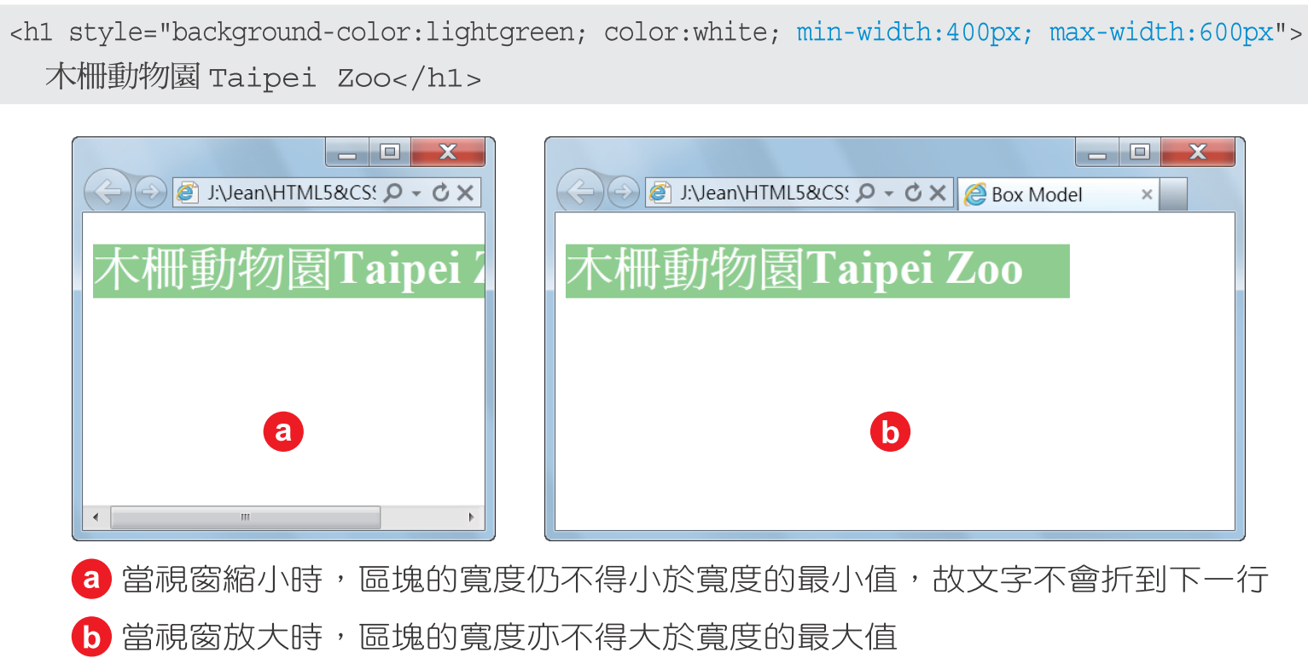
寬度下限 min-width 寬度上限 max-width

Slide 15
Position 屬性
Value | Description
static | Default. Elements render in order, as they appear in the document flow
absolute | The element is positioned relative to its first positioned (not static) ancestor element
fixed | The element is positioned relative to the browser window
relative | The element is positioned relative to its normal position, so "left:20" adds 20 pixels to the element's LEFT position
inherit | The value of the position property is inherited from the parent element
Notes:
http://www.w3schools.com/cssref/pr_class_position.asp

Slide 16

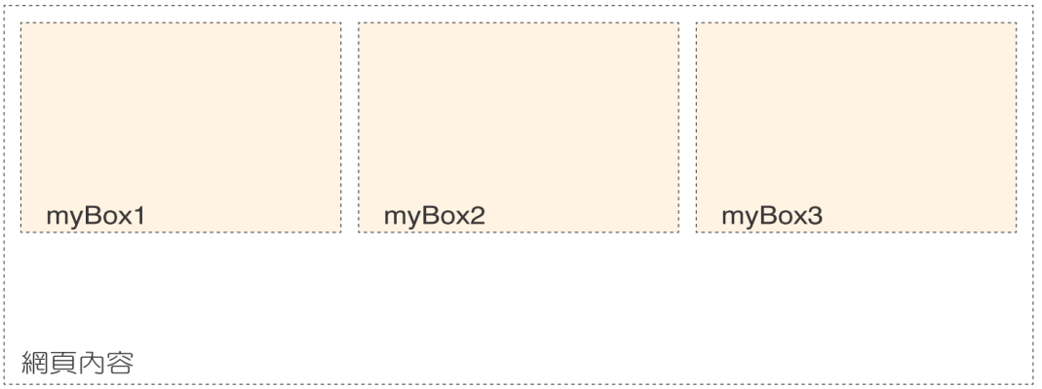

Slide 17
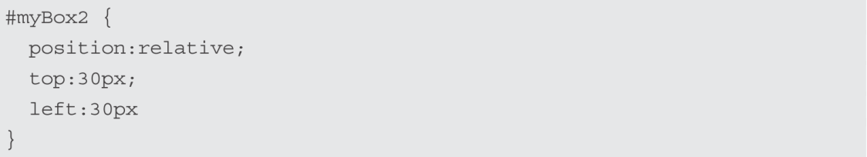
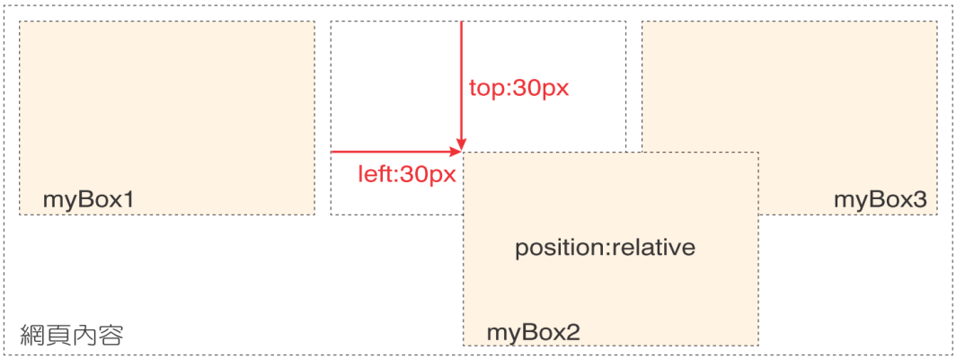

Slide 18
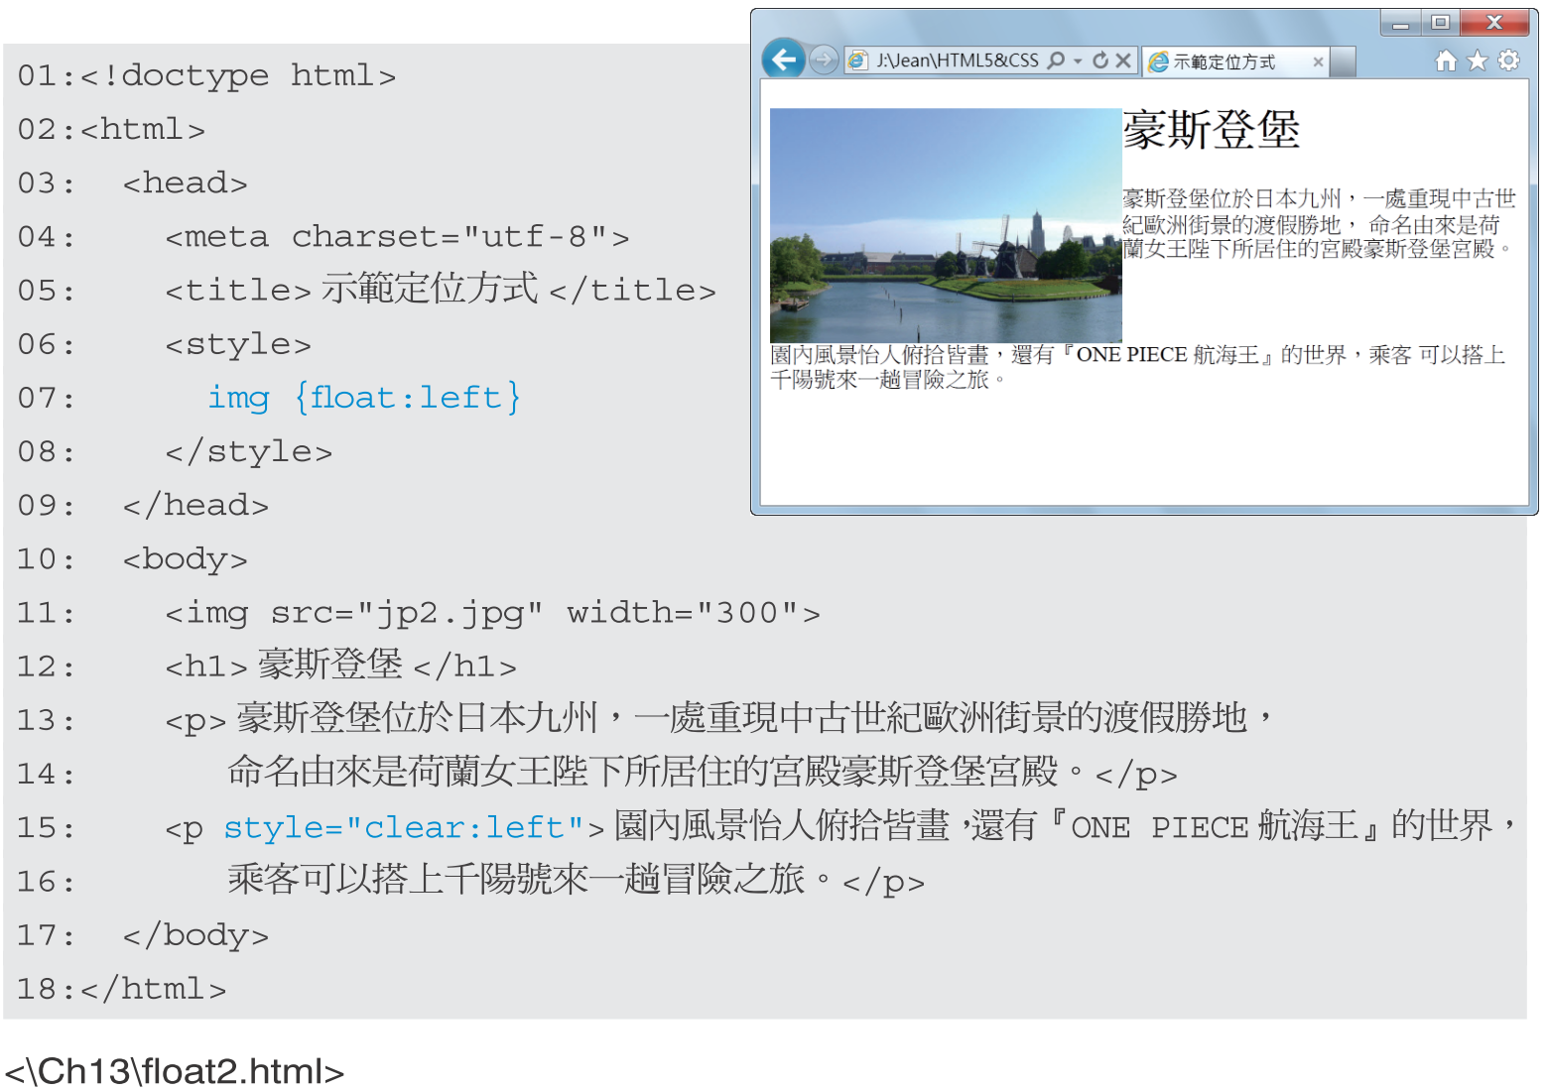
指定文繞圖 ﬂoat 解除文繞圖 clear

Slide 19
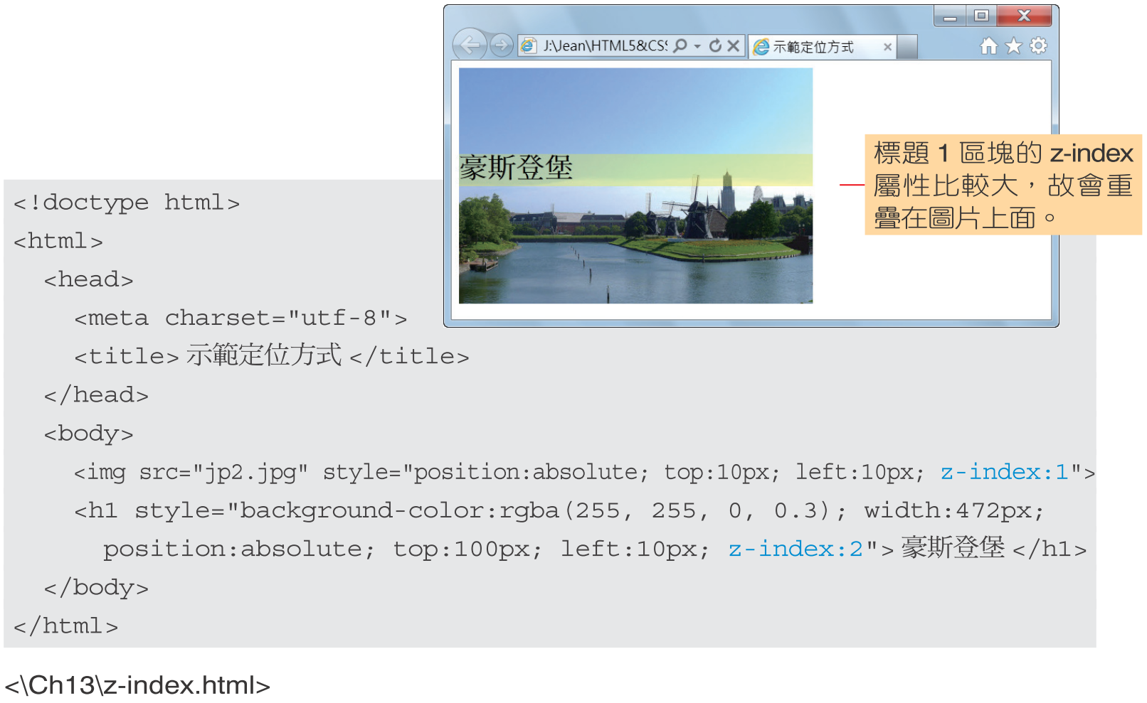
重疊順序 z-index

Slide 20
顯示或隱藏 visibility
Value | Description
visible | Default. The element is visible
hidden | The element is invisible (but still takes up space)
collapse | Only for table elements. collapse removes a row or column, but it does not affect the table layout. The space taken up by the row or column will be available for other content. If collapse is used on other elements, it renders as "hidden"
Notes:
http://www.w3schools.com/cssref/pr_class_visibility.asp

Slide 21
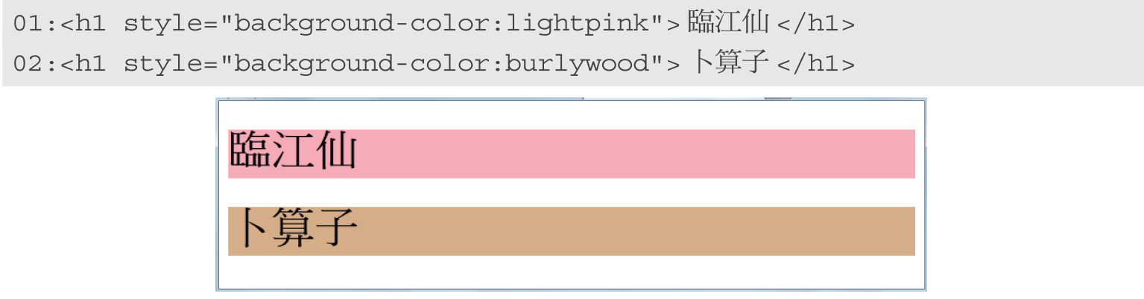
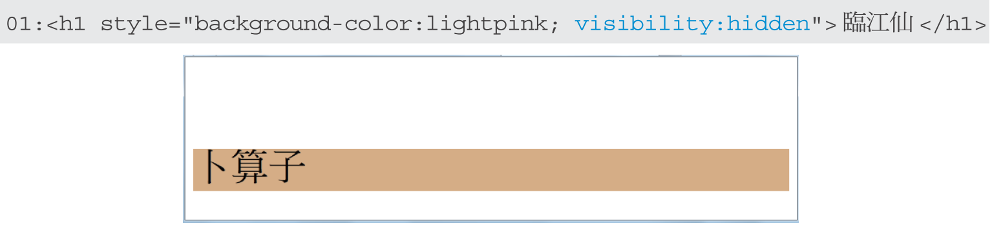
顯示或隱藏 visibility

Slide 22
溢出 overﬂow
Value | Description
visible | The overflow is not clipped. It renders outside the element's box. This is default
hidden | The overflow is clipped, and the rest of the content will be invisible
scroll | The overflow is clipped, but a scroll-bar is added to see the rest of the content
auto | If overflow is clipped, a scroll-bar should be added to see the rest of the content
Notes:
http://www.w3schools.com/cssref/pr_pos_overflow.asp

Slide 23
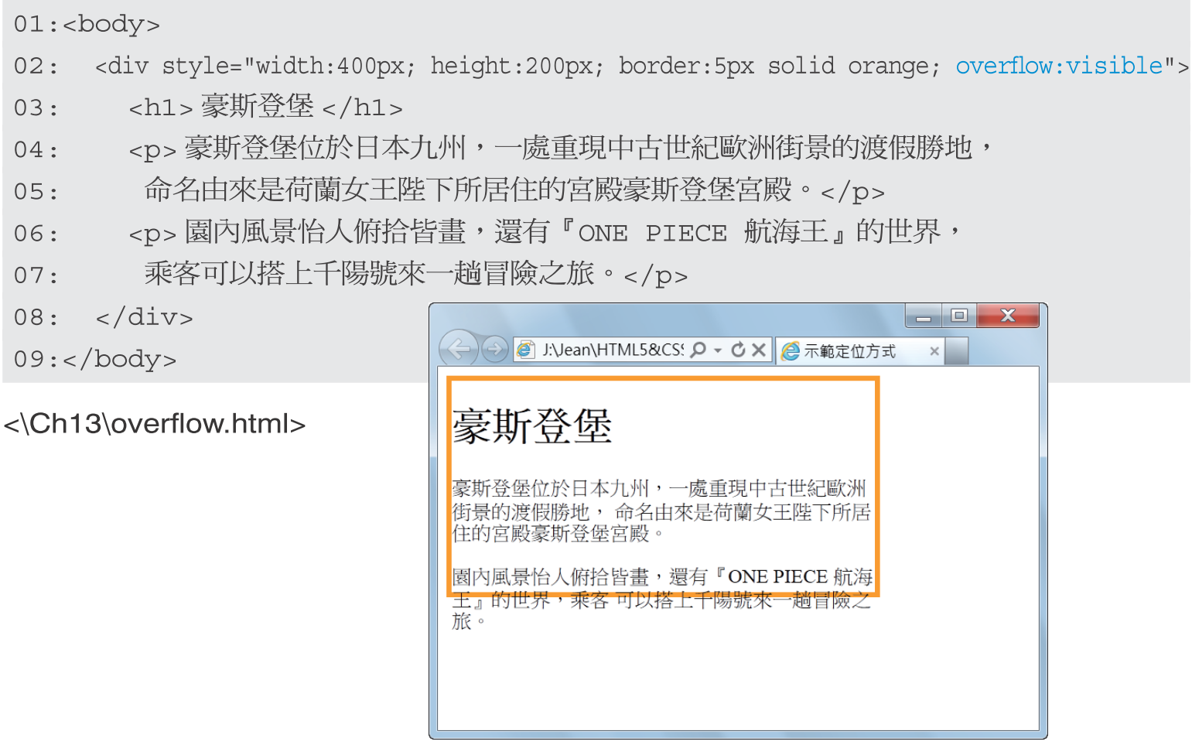

Slide 24
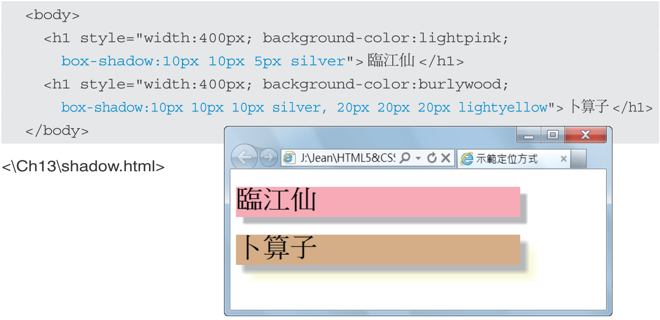
陰影 box-shadow
Notes:
http://www.w3schools.com/cssref/css3_pr_box-shadow.asp

Slide 25
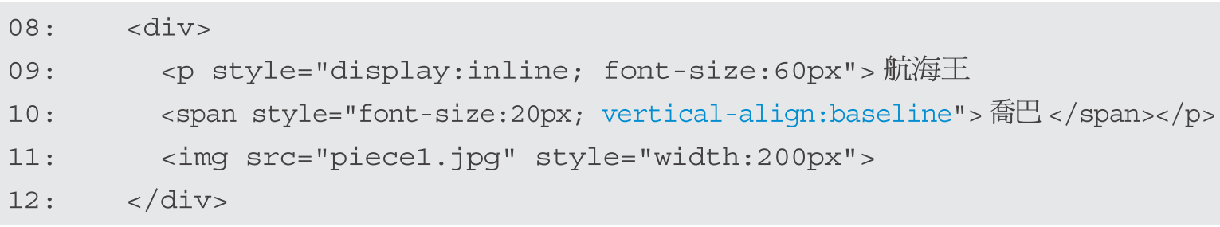
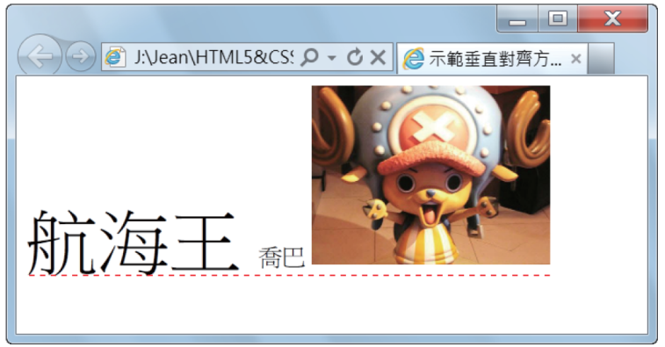
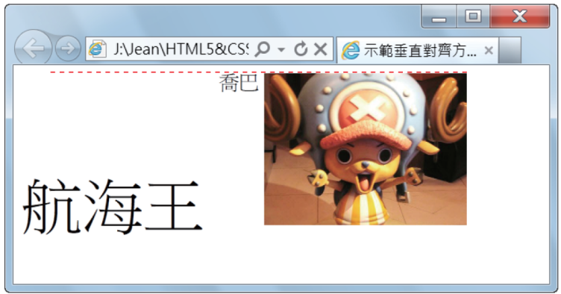
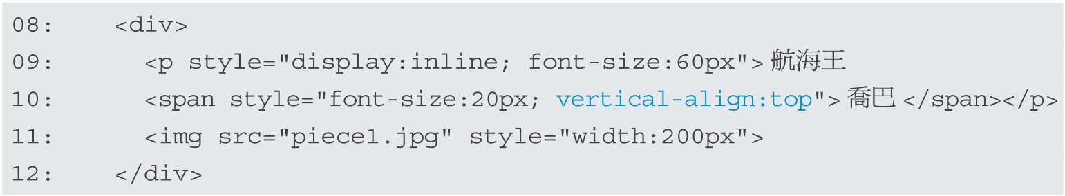
垂直對齊 vertical-align

Slide 26

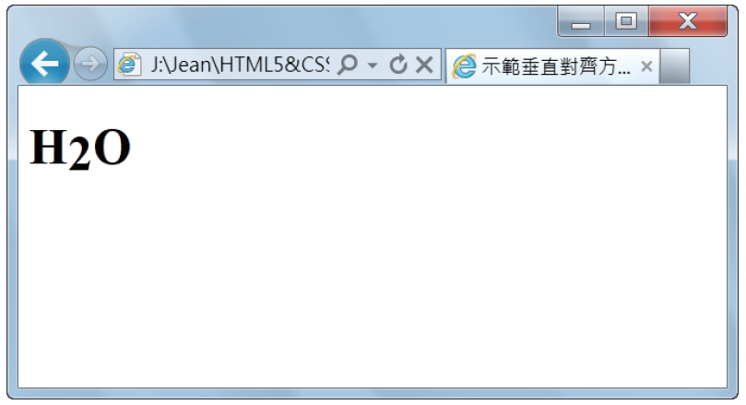
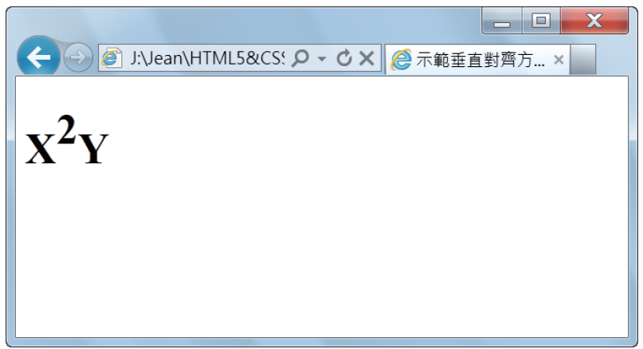

垂直對齊 vertical-align

Slide 27
Flexbox
Flexbox 是一個 CSS3 的盒子模型（Box Model）
靈活的盒子（Flexible Box）
在一個容器（Container）安排多個元件項目（Item）的排列方式

Slide 28
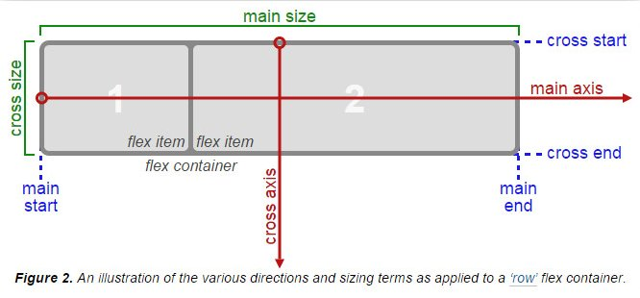
Flexbox 容器
Notes:
https://www.oxxostudio.tw/articles/201501/css-flexbox.html

Slide 29
Flexbox 屬性
display: 顯示方式
flex-direction: 排列方向
justify-content: 項目的水平對齊位置
align-items: 項目的垂直對齊位置
align-self: 項目本身的排列方式
align-content: 多行模式的 align-items
flex-wrap: 寬度超過時自動換行
order: 項目的排列順序
flex: 自動放大縮小

Slide 30
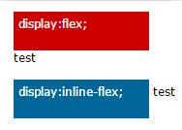
Flexbox 屬性 display
顯示方式，值：
flex 單獨一行
Inline-flex 與左右文字同一行
Notes:
https://www.oxxostudio.tw/articles/201501/css-flexbox.html

Slide 31
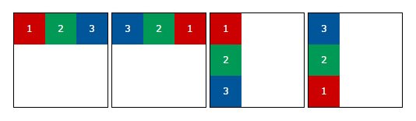
Flexbox 屬性 flex-direction
排列方向，值：
row：預設值，由左到右，從上到下
row-reverse：與 row 相反
column：從上到下，再由左到右
column-reverse：與 column 相反
Notes:
https://www.oxxostudio.tw/articles/201501/css-flexbox.html

Slide 32
Flexbox 屬性 justify-content
水平對齊位置，值：
flex-start：預設值，對齊最左邊的 main start
flex-end：對齊最左邊的 main end
center：水平置中
space-between：平均分配，左右項目與 main start 和 main end 貼齊
space-around：平均分配，間距平均分配
Notes:
https://www.oxxostudio.tw/articles/201501/css-flexbox.html

Slide 33
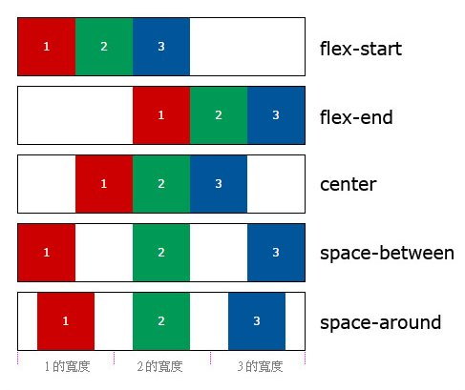
Flexbox 屬性 justify-content

Slide 34
Flexbox 屬性 align-items
垂直對齊位置，值：
flex-start：對齊最上面的 cross start
flex-end：對齊最下面的 cross end
center：垂直置中
stretch：預設值，全部撐開至 Flexbox 的高度
baseline：以基線作為對齊標準
Notes:
https://www.oxxostudio.tw/articles/201501/css-flexbox.html

Slide 35
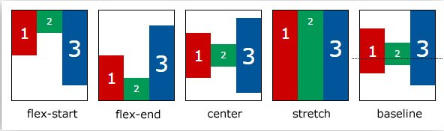
Flexbox 屬性 align-items

Slide 36
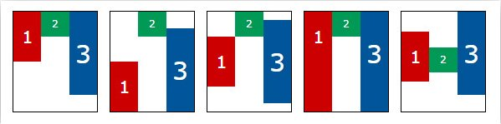
Flexbox 屬性 align-self
align-self 的設定與 align-items 相同，但目的不同
align-self 的作用在於覆寫已經套用 align-items 的屬性
.item2{
align-self:baseline;
}
Notes:
https://www.oxxostudio.tw/articles/201501/css-flexbox.html

Slide 37
Flexbox 屬性 align-content
多行的 align-items，值：
flex-start：對齊最上面的 cross start
flex-end：對齊最下面的 cross end
center：垂直置中
space-between：將第一行與最後一行分別對齊最上方與最下方
space-around：每行平均分配間距
stretch：預設值，內容項目全部撐開
Notes:
https://www.oxxostudio.tw/articles/201501/css-flexbox.html

Slide 38
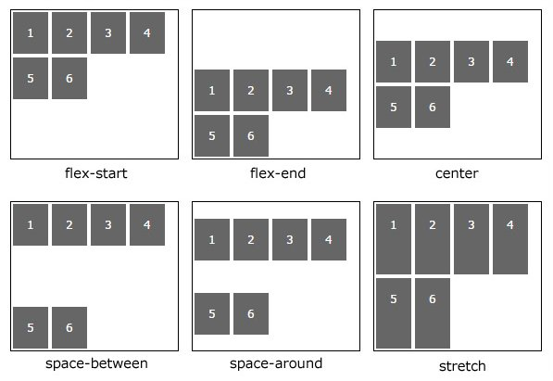
Flexbox 屬性 align-content

Slide 39
Flexbox 屬性 flex-wrap
自動換行，值：
nowrap：預設值，單行，不自動換行
wrap：自動換行，多行
wrap-reverse：自動換行，但內容項目反轉
Notes:
https://www.oxxostudio.tw/articles/201501/css-flexbox.html

Slide 40
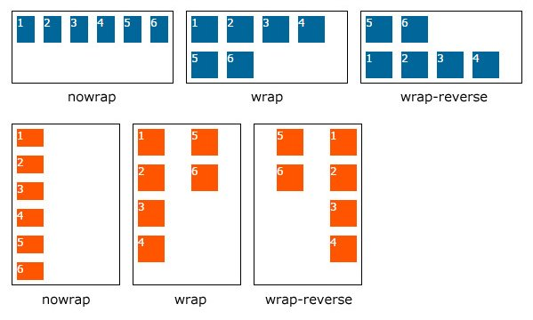
Flexbox 屬性 flex-wrap

Slide 41
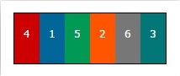
Flexbox 屬性 order
.item{
width:50px;
height:60px;
text-align: center;
line-height: 50px;
}
.order1{
order:1;
background:#c00;
}
.order2{
order:2;
background:#069;
}
.order3{
order:3;
background:#095;
}
.order4{
order:4;
background:#f50;
}
.order5{
order:5;
background:#777;
}
.order6{
order:6;
background:#077;
}
項目排序
Notes:
https://www.oxxostudio.tw/articles/201501/css-flexbox.html

Slide 42
Flexbox 屬性 flex
flex: grow shrink basis
flex-grow：數字，無單位，當子元素的 flex-basis 長度「小」於它自己在父元素分配到的長度，按照數字做相對應的「伸展」比例分配，預設值為 0，不會進行彈性變化，不可為負值，設為 1 則會進行彈性變化。
flex-shrink：數字，無單位，當子元素的 flex-basis 長度「大」於它自己在父元素分配到的長度，按照數字做相對應的「壓縮」比例分配，預設值為 1，設為 0 的話不會進行彈性變化，不可為值。
flex-basis：子元素的基本大小，作為父元素的大小比較基準，預設值為 0，也因為預設值為 0，所以沒有設定此屬性的時候，會以直接採用 flex-grow 屬性，flex-basis 也可以設為 auto，如果設為 auto，就表示子元素以自己的基本大小為單位。
Notes:
https://www.oxxostudio.tw/articles/201501/css-flexbox.html

Slide 43
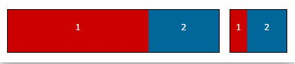
Flexbox 屬性 flex
.item1{
flex:1 2 200px;
background:#c00;
}
.item2{
flex:2 1 100px;
background:#069;
}

Slide 44
練習1：玩玩 Flexbox Froggy
玩玩 Flexbox Froggy 熟悉 Flexbox 的元件佈置方式
https://flexboxfroggy.com

Slide 45
結語
Box Model
Margin 留白在框線外
Padding 留白在框線內
Position 決定 Box 的排列方式與位置
z-index 決定圖層順序
visibility 可將元件隱藏起來
Flexbox 彈性安排項目的排列方式
Notes:
http://kourge.net/files/nvu/pres.html

